Slide 1
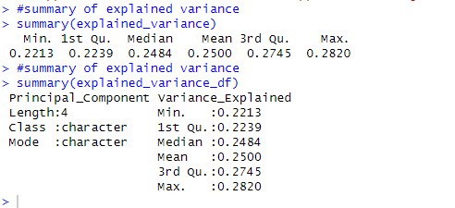
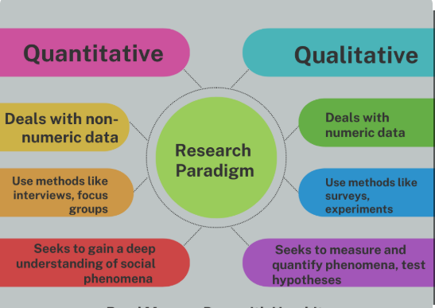
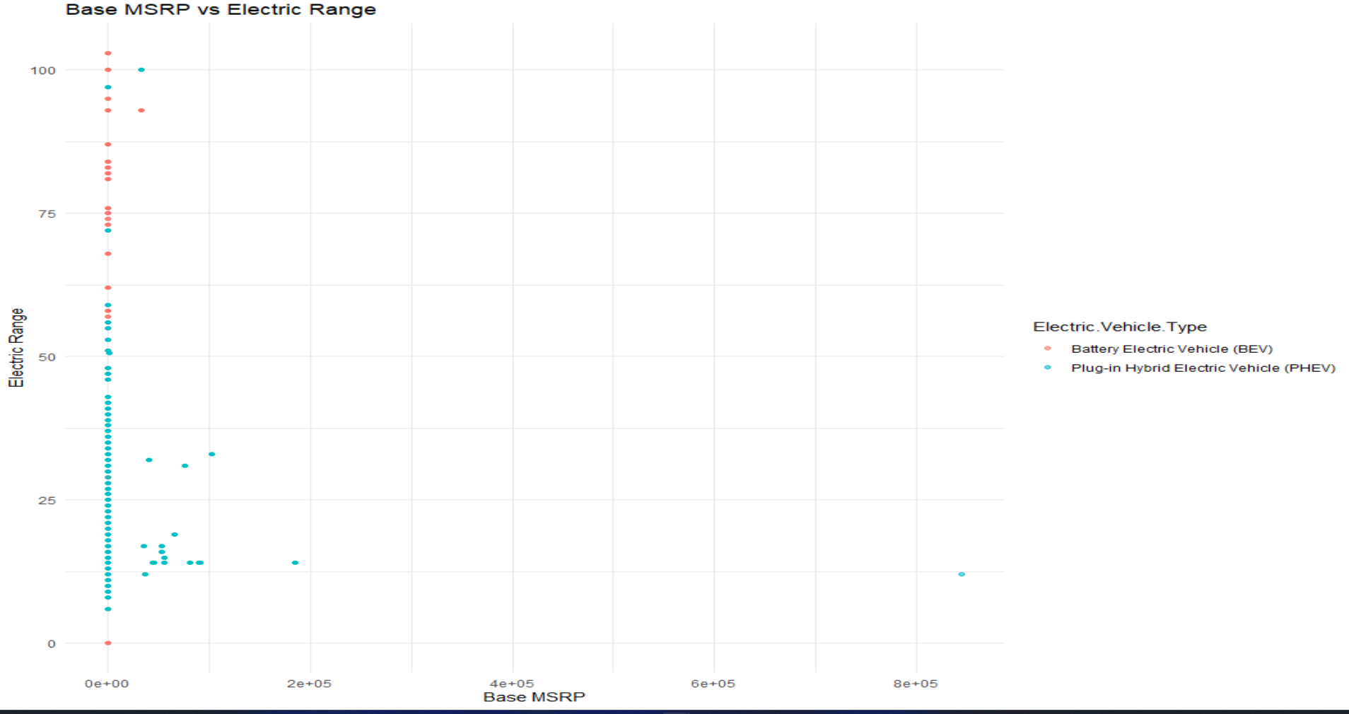
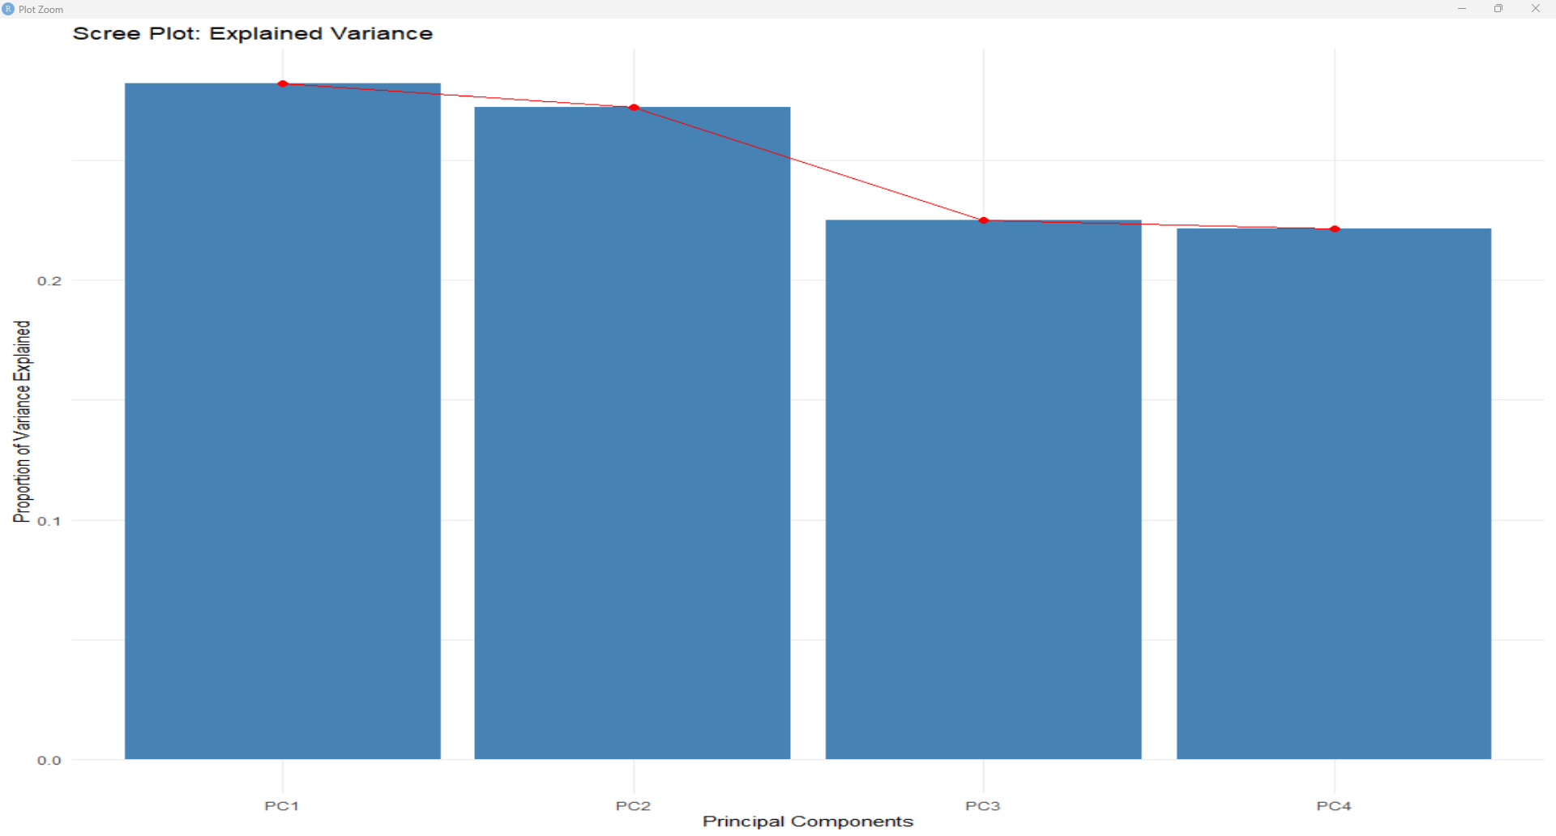
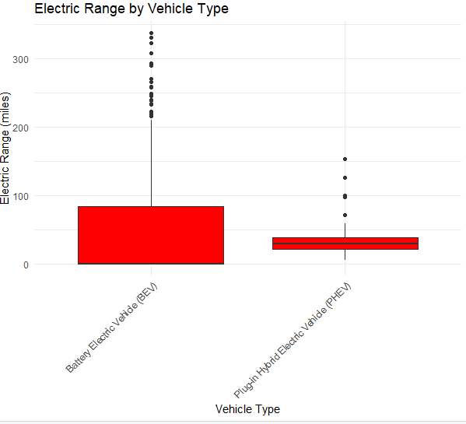
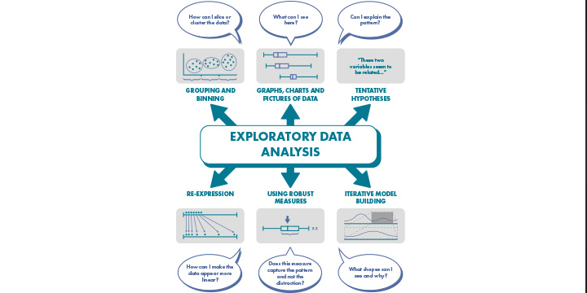
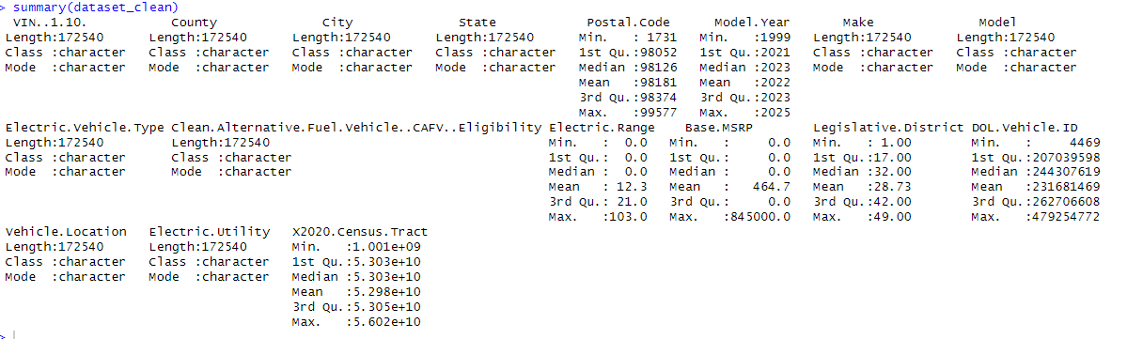
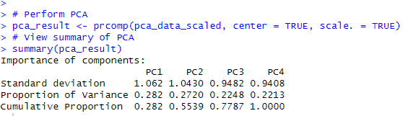
The use of exploratory data analysis (EDA) and Principal Component analysis(PCA) to maximize understanding of some information that was given
Erick da Silva Zumba, CCT College Dublin (Bsc Cohort 9), Nov 2024
ABSTRACT
RESEARCH PARADIGM
FINDINGS
FINDINGS
The main goal of working with a dataset is to maximise the potential of the data and potentially insert this information into AI and subsequently to ML. The research goal was to gather any data and transform it to something useful, for example, a resource to feed the AI. This is a powerful tool and needs accurate information. The process of inputting this information using AI is still new. Whereas, where there is human input into the data inputting process this can result in mistakes due to human error. Whereas, when using this process with AI, the chances of these mistakes being made are greatly lowered, if not eliminated completely. For instance, the current use of AI within the medical field to accurately perform surgical procedures. The risk of accidents is significantly less than when being performed by a human surgeon.
The research study were defined in a deterministic approach, which determines data and transform all this information to a better comprehension. The main goal was to produce some input based on information that was given by client or patients but asking them for the permission to use this data to help the solve a problem which intrinsically supports all the experiment.
Reflective Learning
Some of the results of the mean, median and IQR for the principal component analysis is showing on the image below one the method used was to concatenate two vector after converting to a sting which is paste0.
Some of the difficulties we face was first find something we have a passion to talk about , and we implementing the code some functionalities even some formulas to obtain a certain result using the dataset that was challenging. The dataset was clean using the method na.omit which goes through the data analysing the one with NA and removing them from the table because it’s a bad input to have on your dataset mutate which consist in creating new variables for the data set. Another feature that we use was Interquartile range to help to clean and obtain some of the outliers that is shown on the graph below.
RESEARCH QUESTIONS
Q.1. Is a Data Exploration and Preparation a useful and effective tool for making the data more precise to demonstrate this to user?
Q.2. Using those technologies such as DEP can enhance student engagement and learning curve?
Q.3 Are EDA and PCA techniques, such as Handle outliers using IQR and reduction of the data, Could they be powerful for illustrated the process of something to a person that has no knowledge in IT?
Q.4 How can we use those strategies to enhance data exploratory /principal component in DEP afterwards introduce this concept to AI and ML?
CONCLUSIONS
We concluded that the EDA an PCA are good features to evaluated data and give people a better understating for any subject , the process of obtaining data is the hard part to get because you need people permission. To use or to do any study with data obtained have to give a document for each individual one saying the give full consent to use the information.
The advantage of studying this data is for later start to introduce this to AI which is a powerful tool and if used correctly can be one the best ally that you might have but that cannot be your resource to fix a problem.
Research Methods
The EDA show some the outliers that was identified , another topic is the principal component analysis for that matter we got the data that was used to do EDA and applied the PCA on it.
CONCEPTUAL FRAMEWORK
The data that was chosen was based on problem that is the cars using fuel which pollutes the Environment, we gather information of electric cars which would not produce any CO2 and helps reduce the global warming. We will evaluated electric cars only and show the range between a hybrid and battery one.
The concept for this framework below, A includes key concepts, variables, relationships, and assumptions that guide the academic inquiry. It establishes the theoretical underpinnings and provides a lens through which researchers can analyse and interpret data.
REFERENCES
https://jcu.pressbooks.pub/intro-res-methods-health/chapter/1-3-research-paradigms-and-philosophical-assumptions/#:~:text=It%20is%20the%20lens%20through,for%20data%20collection%20and%20analysis.&text=Research%20paradigms%20consist%20of%20four,ontology%2C%20epistemology%2C%20and%20methodology.
https://researcher.life/blog/article/what-is-a-research-paradigm-types-examples/
For the coding process some of the examples from the slides of the class was incorporated and applied on that matter
https://www.digitalocean.com/community/tutorials/paste-in-r
Video: https://drive.google.com/file/d/1l2URIM33dPOjFOXWsl4TpBd-39hMD8YH/view?usp=sharing
Data Collection
Summarizing PCA
The table below is a summary of the data collected for the study.
We have done the standard deviation formula and some other aspects that need to calculate, on image below shows the result of PC1,PC2, PC3 and PC4.

